Slide 1
School of Engineering
EG5066 Energy Technologies: Current Issues and Future Directions
Carbon Capture and Storage
Jeff Gomes
November 2013
jefferson.gomes@abdn.ac.uk

Slide 2
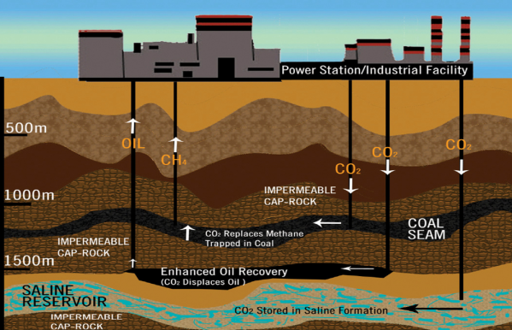
Outline
Energy Consumption
Why CCS
Capture Technologies
Transport Technologies
Storage Technologies
Risks of Geological Storages
jefferson.gomes@abdn.ac.uk

Slide 3
Motivation
jefferson.gomes@abdn.ac.uk

Slide 4
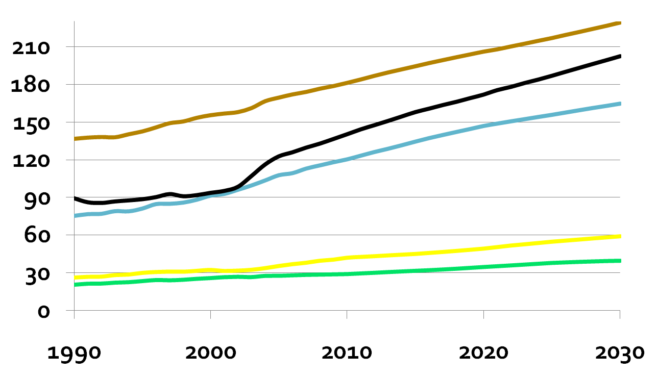
Energy Consumption
Oil
Coal
NG
Quad. BTU
Nuclear
Renewable
Year
Quad BTU = 10¹⁵ BTU = 33.434 GW-years
Source: IEA (2011)
jefferson.gomes@abdn.ac.uk
Notes:
Coal consumption will rise from 123 quads in 2006 to over 200 quads in 2030 (assuming price of oil = $70 2006 dollars in 2030) and account for 29% of all energy consumption. Renewables can’t get here fast enough and are expensive. Cost of carbon dioxide should be around $60/tonne, at which point coal is
4

Slide 5
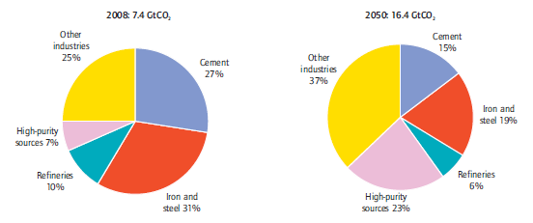
Industrial CO₂ Emission Projections
Global Primary:
Energy supply: 12267 million tonnes of oil equivalent (Mtoe) with,
CO₂ emissions: 29 Gt
Total industry and fuel transformation:
Energy supply: 4254 Mtoe
CO₂ emissions: 7.4 Gt
And ...
Source: IEA (2011)
jefferson.gomes@abdn.ac.uk

Slide 6
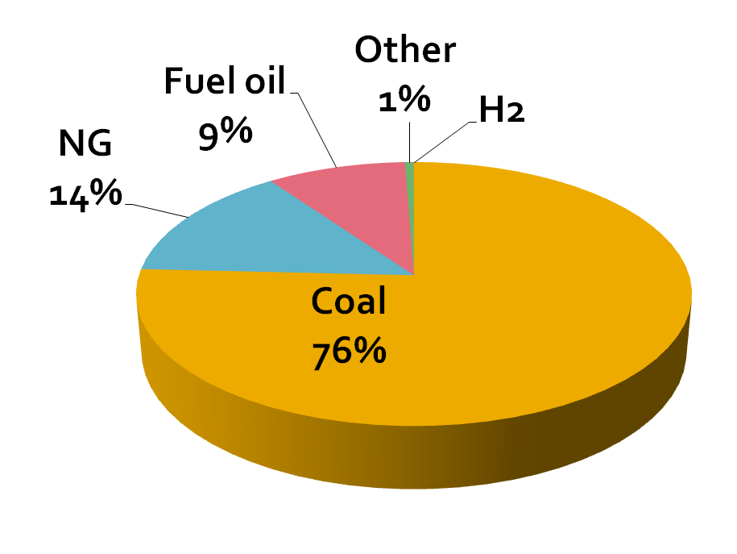
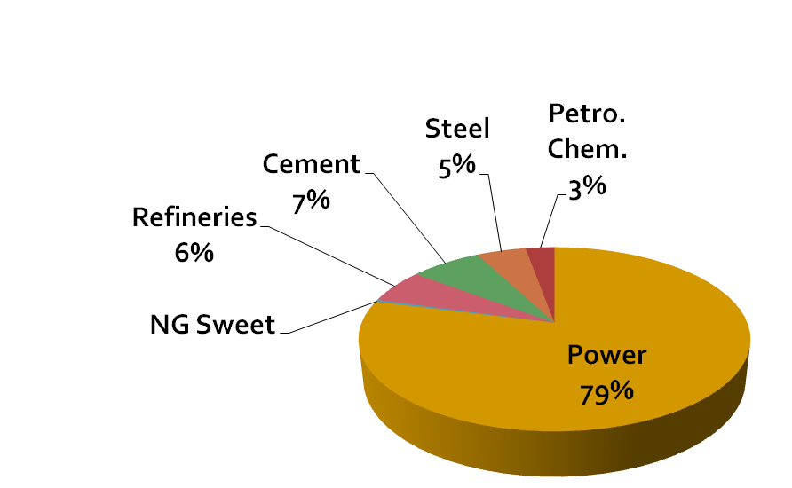
Industrial CO₂ Emissions from Electricity
(60% of total)
2006: Total 10.5 Mtoe or 79% of all emissions are from power plants to generate electricity.
Source: IEA (2011)
jefferson.gomes@abdn.ac.uk

Slide 7
IPCC Conclusions for Emissions Mitigation Potential
CO₂ concentration is the highest in the last 650k years
Global GHG emissions reduction challenge:
To cap CO₂ conc. at 450ppm → leading to temperature rise of 2.0-2.4°C;
To reduce 2050 emissions to ~75% of 2000 emissions → to target reducing annual global emissions to 5 Gt CO₂.
➔So there is no ‘silver bullet’ to mitigate CO₂ emissions!
jefferson.gomes@abdn.ac.uk

Slide 8
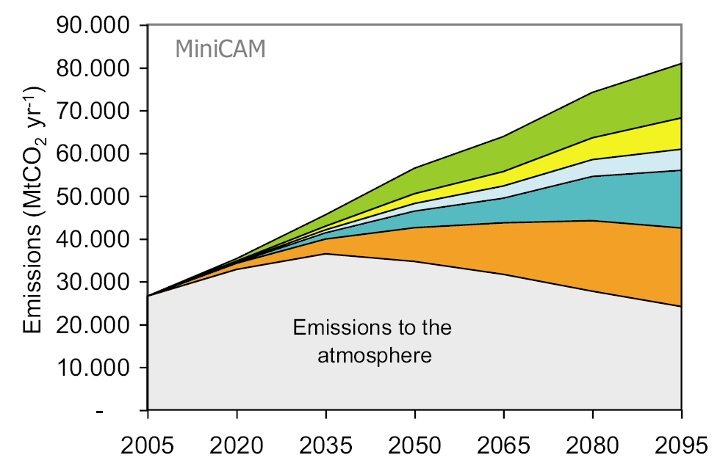
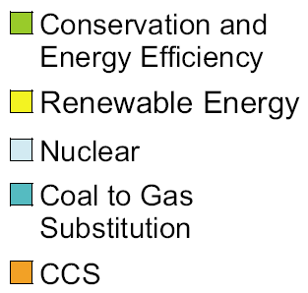
IPCC Conclusions for Emissions Mitigation Potential
Source: IPCC (2005)
jefferson.gomes@abdn.ac.uk

Slide 9
Carbon Capture and Storage (CCS)
CCS are set of process technologies aiming to remove CO₂ from industry fluid stream and reroute it into a contained storage site.
Capture
Power plants;
NG treatment;
Oil refineries;
etc
Transportation
Pipelines;
Ships;
Storage
Underground geological formations;
Ocean.
Although it is a relatively expansive process, O&G industry became specially interested on the storage technology in geological formations as an analogue to enhanced oil recovery technology.
jefferson.gomes@abdn.ac.uk

Slide 10
Main Carbon Capture and Storage Facilities
Country | Location | Capacity (Mt CO₂/year) | Start Year | Storage Type
USA (Texas) | Val Verde (Gas plant) | 1.3 | 1972 | EOR
USA (Oklahoma) | Enid | 0.7 | 1982 | EOR
USA (Wyoming) | Shute Creek | 7 | 1986 | EOR
Norway (North Sea) | Sleipner | 1 | 1996 | LGS
USA (North Dakota) | Great Plains | 3 | 2000 | EOR
Algeria | In Saliah | 1 | 2004 | LGS
Norway (Barents Sea) | Snohvit | 0.7 | 2008 | LGS
USA (Texas) | Century | 8.4 | 2010 | EOR
Total |  | 23.1
LGS: Long-term geological storage
EOR: Enhanced oil recovery
Source: IEA (2013)
jefferson.gomes@abdn.ac.uk

Slide 11
Shell CCS Quest in Canada
http://www.youtube.com/watch?v=cZqEfupKlJs
jefferson.gomes@abdn.ac.uk

Slide 12
Carbon Capture
jefferson.gomes@abdn.ac.uk

Slide 13
Suitable CO₂ sources for Capture
Large stationary point source (e.g., power generation plants, industrial processes, synthetic fuel production etc);
High CO₂ concentration in the waste, flue gas or by-product stream (purity)
Pressure of CO₂ stream
Distance from suitable storage sites
jefferson.gomes@abdn.ac.uk

Slide 14
Global large stationary CO₂ sources with emissions
(> 0.1 MtCO₂/ year)
Process |  | Number of sources | Emissions (MtCO₂ yr⁻¹)
Fossil fuels | Power | 4,942 | 10,539
 | Cement production | 1,175 | 932
 | Refineries | 638 | 798
 | Iron & steel industry | 269 | 646
 | Petrochemical industry | 470 | 379
 | Oil & gas processing | Not available | 50
 | Other sources | 90 | 33
Biomass | Bioethanol & bioenergy | 303 | 91
Total |  | 7,887 | 13,466
jefferson.gomes@abdn.ac.uk

Slide 15
Technologies for CO₂ Capture
Three main technologies:
Post-combustion capture: separation CO₂-N₂;
Pre-combustion capture: separation CO₂-H₂;
Oxyfuel combustion capture : separation O₂-N₂
 | Post-comb. (flue gas) | Pre-comb. (shifted syngas) | Oxyfuel comb. (exhaust)
p (bar) | ~1 bar | 10-80 | ~1 bar
[CO₂] (%) | 3-15% | 20-40% | 75-95%
jefferson.gomes@abdn.ac.uk

Slide 16
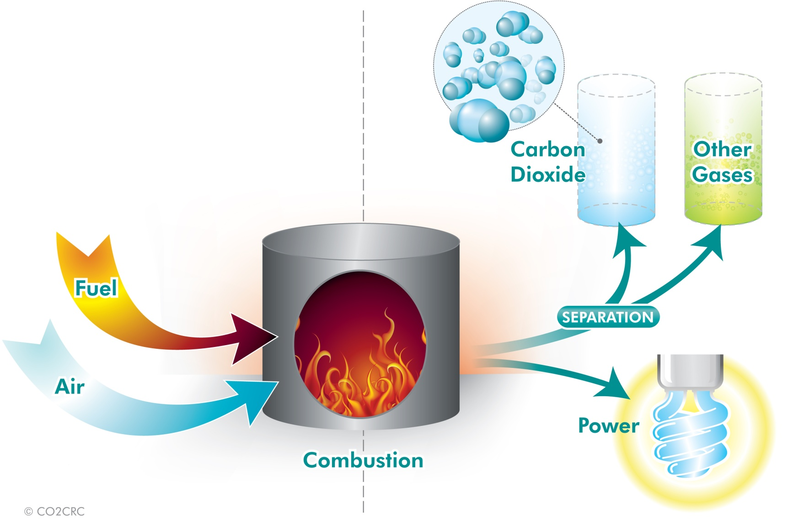
Technologies for CO₂ Capture: Post-Combustion
Absorption/Stripping:
Source: http://www.co2crc.com.au/
jefferson.gomes@abdn.ac.uk

Slide 17
Technologies for CO₂ Capture: Post-Combustion
Absorption/Stripping:
CO₂ + OH-C₂H₄-NH₂ + B →OH-C₂H₄-NH-CO₂ + BH + Heat
Absorption of CO₂ by MEA at 40°C
MEA recovery by desorption at 120°C
Reboiler provides heat to desorber in the form of steam from the boiler, reducing plant output and efficiency
Optimize loading, operating temperature, minimize solvent losses.
Ethanolamine (MEA)
jefferson.gomes@abdn.ac.uk

Slide 18
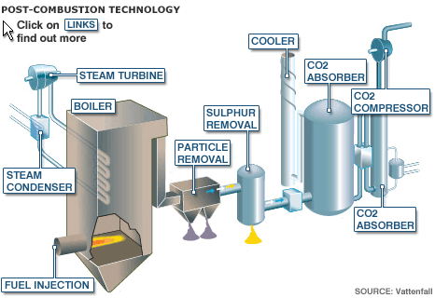
Technologies for CO₂ Capture: Post-Combustion
Flue gas cooled & brought into contact with amine solution
CO₂ bound to amine solution & transported to stripper
Chemical reaction binding CO₂ with amine reversible
Amine solution regenerated in scrubber
Captured CO₂ compressed & dehydrated
jefferson.gomes@abdn.ac.uk

Slide 19
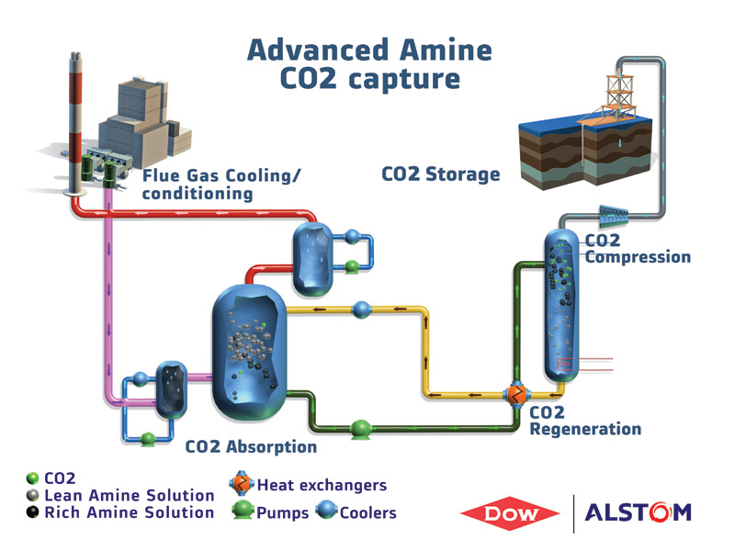
Technologies for CO₂ Capture: Post-Combustion
Pros:
Feasible to retrofit to current industrial plants and power stations.
Existing technology - 60 years experience with amine solvents - but needs 10x scale-up.
Currently in use to capture CO₂ for soft drinks industry.
Cons:
High running costs – absorber and degraded solvents replacement.
Limited large scale operating experience.
jefferson.gomes@abdn.ac.uk

Slide 20
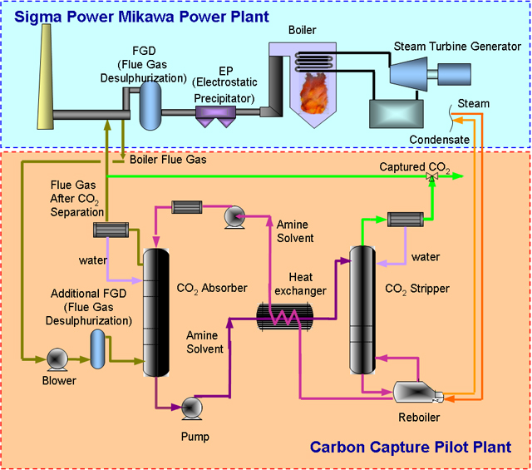
Technologies for CO₂ Capture: Post-Combustion
CCS
Toshiba Technology.
Pilot plant in Omuta City (Japan).
Started on Sept 2009.
Recovery energy: < 2.6GJ/t-CO₂ for 90% CO₂ capture with 12% of concentration).
jefferson.gomes@abdn.ac.uk

Slide 21
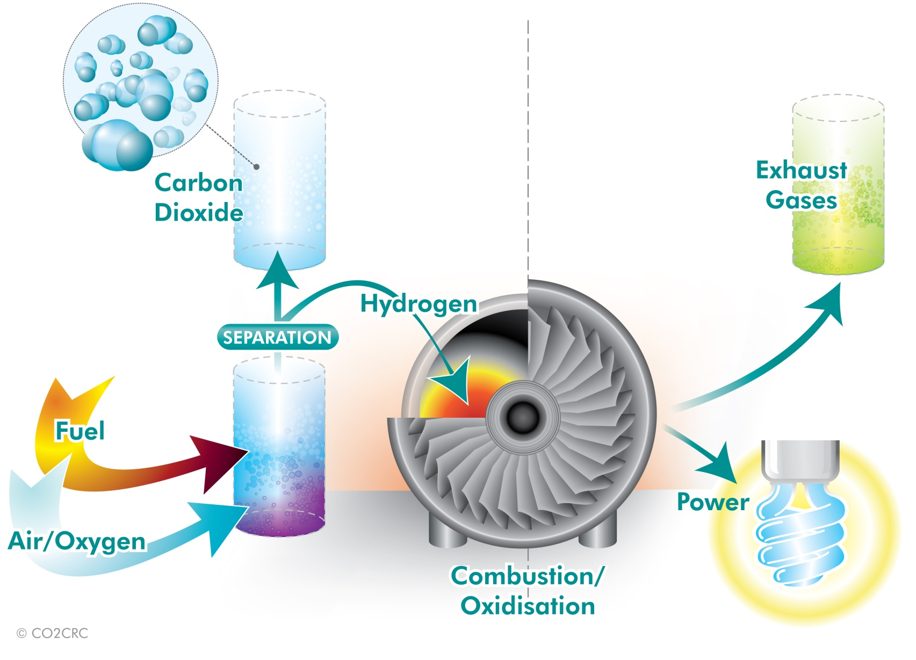
Technologies for CO₂ Capture: Pre-Combustion
Source: http://www.co2crc.com.au/
jefferson.gomes@abdn.ac.uk

Slide 22
Technologies for CO₂ Capture: Pre-Combustion
1st stage – to produce syngas (H₂ + CO)
Two routes:
Steam reforming – steam added to primary fuel
C_{x}H_{y} + xH₂O
xCO + (x + y/2)H₂
Partial oxidation of gaseous fuels (gasification)
C_{x}H_{y} + 0.5xO₂
xCO + 0.5yH₂
2nd stage water gas shift reaction to convert the CO into CO₂
CO + H₂O
CO₂ + H₂
jefferson.gomes@abdn.ac.uk

Slide 23
Technologies for CO₂ Capture: Pre-Combustion
Combined cycle power block
Electricity
Steam
O₂
CO₂
Capture
Gas & Steam Turbines
Clean syngas (H₂ + CO)
Coal
Biomass
Industrial wastes
Gasifier
H₂O & CO shift to H₂ & CO₂
H₂S removal
H₂, NH₃
Fischer-Tropsch Liquids
H₂O
Sulphur recovery
Sulphur
Slag
jefferson.gomes@abdn.ac.uk

Slide 24
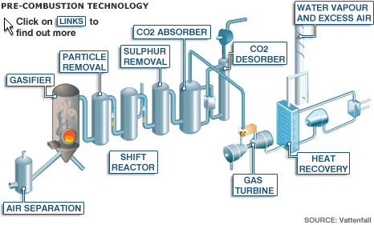
Technologies for CO₂ Capture: Pre-Combustion
Pros:
Proven industrial scale technology in oil refineries, but needs 3x scale-up for power plants.
90-95% of CO₂ emissions can be captured.
Applicable to natural gas, and to coal fired Integrated Gas-Coal Combined Cycle (IGCC) power plants.
Lowest technology risk, and may become the most efficient method.
Can produce H₂ as transportable energy vector, or liquid fuels from coal - but penalties on efficiency
Cons:
Requires a chemical plant in front of gas turbine
High investment cost of dedicated new-build plant.
High NOx emissions – will require expensive scrubbers.
Efficiency of H₂ burning turbines is lower than conventional turbines.
May be less flexible under varying electricity generation market requirement, so base load preferred
jefferson.gomes@abdn.ac.uk

Slide 25
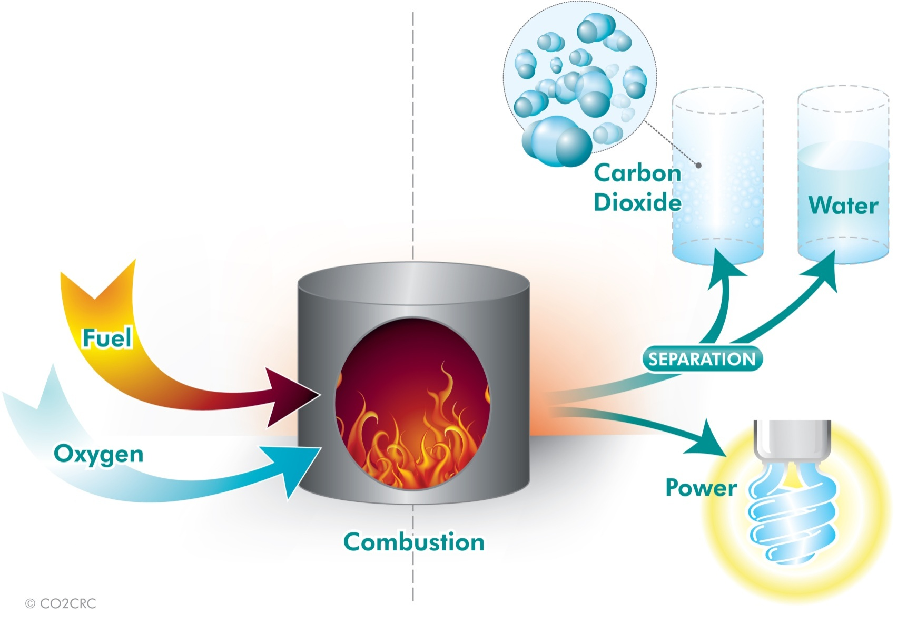
Technologies for CO₂ Capture: Oxyfuel
Fuel is ‘burned’ in a mixture of nearly pure O₂ and CO₂ (recycled from the exhaust stream);
The output from the combustion is the flue gas containing mainly CO₂ and H₂O;
The steam is easily removed from the flue gas by condensation leaving a pure CO2 stream → suitable for compression, transport and storage.
Source: http://www.co2crc.com.au/
jefferson.gomes@abdn.ac.uk

Slide 26
Technologies for CO₂ Capture: Oxyfuel
Eliminates nitrogen from the flue gas by combustion in pure oxygen or mixture of pure oxygen and flue gas so NOx production reduced
Combustion temperature of fuel in pure oxygen is too high so temperaure is controlled by proportion of process heat being recycled back to combustion chamber
Combustion products mainly CO₂ + water vapour + O₂
Combustion products cooled to condense water vapour giving 80 – 98% CO₂ depending on process & fuel
Concentrated CO₂ compressed, dehydated, purified before transport & storage
jefferson.gomes@abdn.ac.uk

Slide 27
Technologies for CO₂ Capture: Oxyfuel
Chemical Looping Combustion
2 stage reaction of hydrocarbon combustion in 2 separate reactors:
Air (oxidiser) Reactor
Fuel (reducer) Reactor
Combustion Products
CO₂, H₂O
Depleted Air
N₂, O₂
*Fuel burns in reducer therefore does not come into contact with air and avoids need for post-combustion capture
MeO
Air Reactor
(Oxidiser)
Fuel Reactor
(Reducer)
Uses metal oxide as a hydrogen carrier
Metal particles reacted with air to give metal oxide
Metal oxide particles react with fuel on fluidised bed reactor to produce:
Metal particles
CO₂ and water vapour
Water vapour condensed leaving pure CO₂
Me
Air
Fuel
jefferson.gomes@abdn.ac.uk

Slide 28
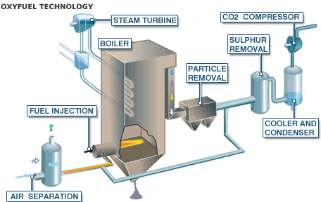
Technologies for CO₂ Capture: Oxyfuel
Pros
Potential for 100% CO₂ capture.
Few other harmful emissions due to more complete combustion.
May be possible to retro-fit the oxy-fuel burners onto modified existing coal power plant
Cons
High energy penalty without chemical looping combustion.
Only at large development stage in 2007 - first Demonstration plants in planning
jefferson.gomes@abdn.ac.uk

Slide 29
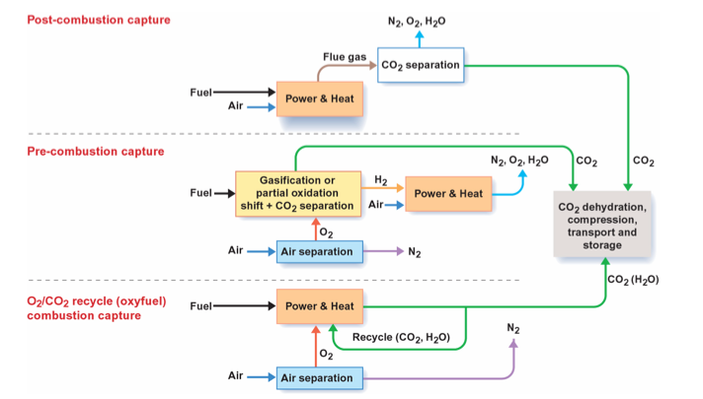
Technologies for CO₂ Capture: Summary
jefferson.gomes@abdn.ac.uk

Slide 30
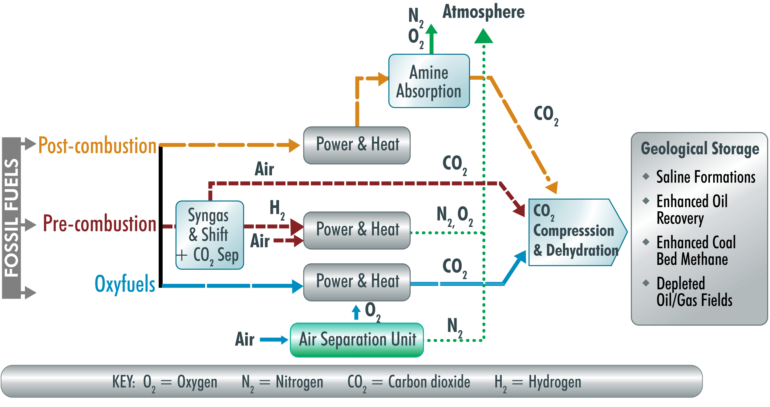
Technologies for CO₂ Capture: Summary
jefferson.gomes@abdn.ac.uk

Slide 31
Carbon Transport
jefferson.gomes@abdn.ac.uk

Slide 32
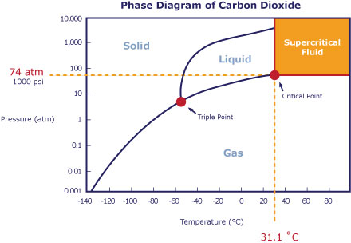
Technologies for CO₂ Transport
Transport CO₂ → Temperature and pressure conditions need to be controlled to prevent solidification (i.e., phase change) and blockages.
At T>T_{c} and P>P_{c}, CO₂ behaves as a gas but has a very high density (e.g., at 100 atm and 45ºC → 463 kg/m³ whereas at 1 atm and 20ºC → 1.815 kg/m³).
Two main methods:
Pipelines (similar to LNG): high-pressure (80-150 bar)
Ships: liquid (14 to 17 bar, -25 to -30°C)
Advantage: flexibility, avoidance of large investments
Disadvantage: high costs for liquefaction and need for buffer storage

Slide 33
Carbon Storage
jefferson.gomes@abdn.ac.uk

Slide 34
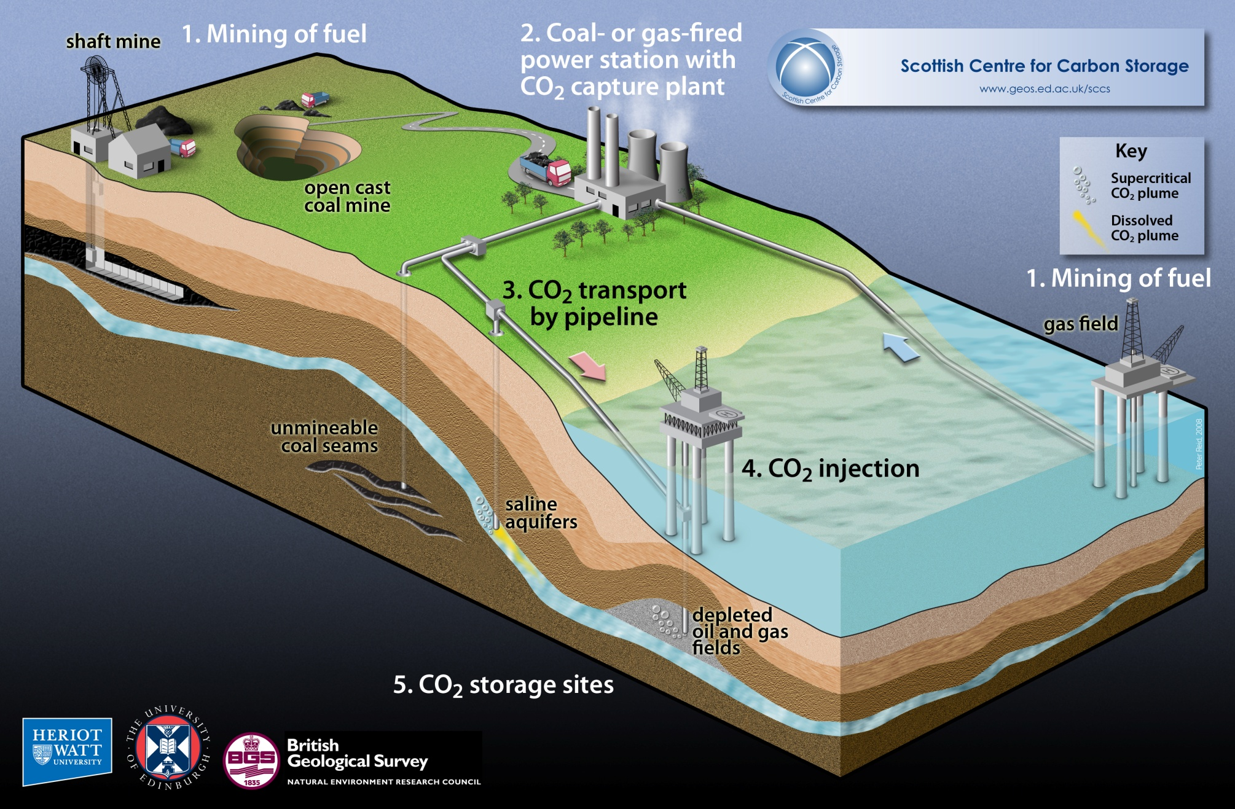
Technologies for CO₂ Storage
jefferson.gomes@abdn.ac.uk

Slide 35
Technologies for CO₂ Storage
Geological Storage
Geological storage capacity at least 2,000 GtCO₂ mainly in oil and gas fields and in formations bearing saline water;
Upper limit uncertain, especially in saline formations;
Specific site characteristics need closer evaluation;
CO₂ injection and reservoir engineering technology for depleted oil & gas fields and saline formations is mature and available;
Monitoring of subsurface movement of CO₂ is being successfully conducted at several sites;
Similarity with Enhanced Oil Recovery technology (injection of supercritical CO₂).
jefferson.gomes@abdn.ac.uk

Slide 36
Technologies for CO₂ Storage
Geological Storage
Fresh water aquifer
Saline aquifer
Depleted Oil and Gas Reservoirs
jefferson.gomes@abdn.ac.uk

Slide 37
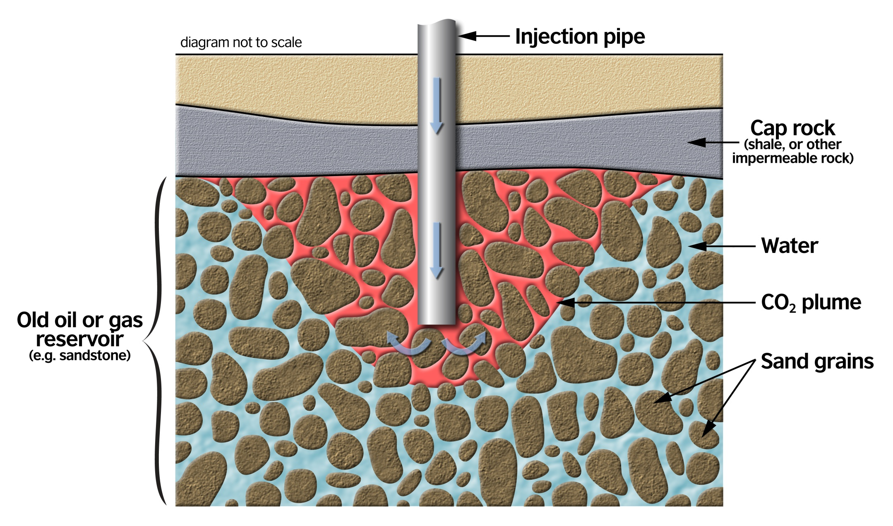
Technologies for CO₂ Storage
Criteria for CO₂ Geological Storage Site
Reservoir: good porosity and permeability.
Seal/caprock: low permeability, low porosity, preferably unfractured.
Structural closure (although not essential)
Formation below 800m: CO₂ exists in its dense phase
Geologically stable area
Source: EU Directive 2009/31/EC on the geological storage of carbon dioxide.
jefferson.gomes@abdn.ac.uk

Slide 38
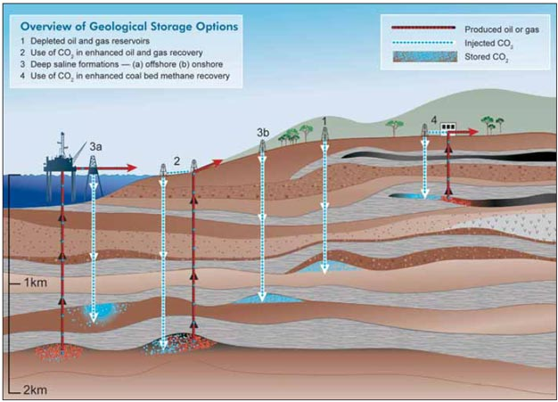
Technologies for CO₂ Storage
Source: IPCC
jefferson.gomes@abdn.ac.uk

Slide 39
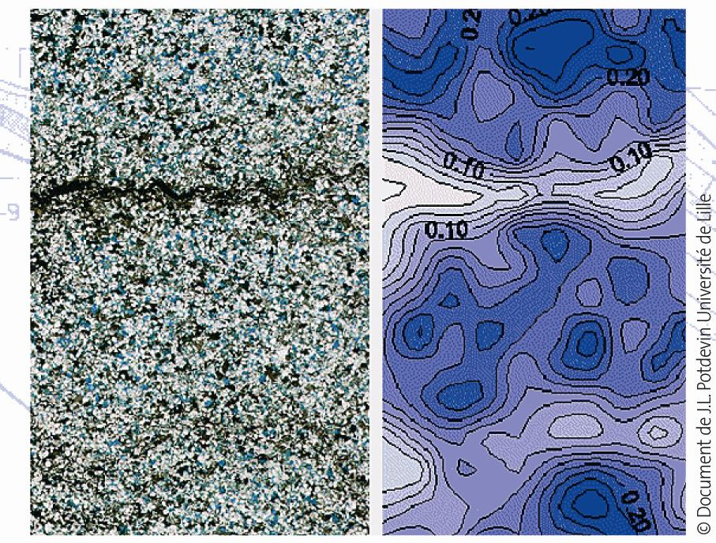
Technologies for CO₂ Storage
Storage Conditions
Porous and permeable rocks that can contain (a mixture of) gas and liquid
Rocks with pores of typically 5-30% of volume of the rock (with diameters of nm-mm)
A sealing by a non permeable rock layer
Typical Reservoir size is 0.05-50 km³
Porosity map: contour map (right) and corresponding sandstone cross-seciton.
jefferson.gomes@abdn.ac.uk

Slide 40
Technologies for CO₂ Storage
Immobilization and Trapping Mechanisms
http://www.youtube.com/watch?v=azLVjYij5U4&list=PL9C407E83C278B36F
jefferson.gomes@abdn.ac.uk

Slide 41
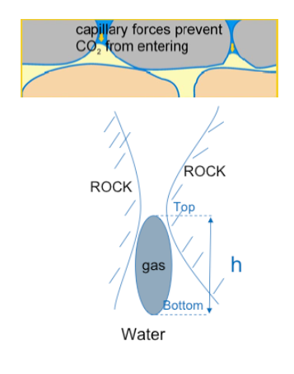
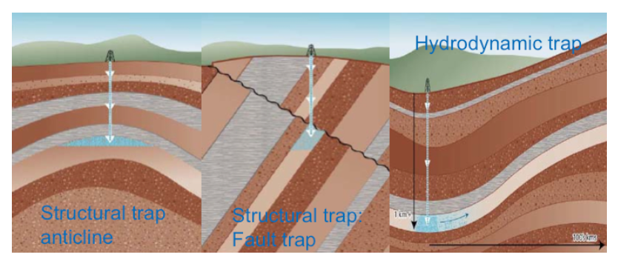
Technologies for CO₂ Storage
Immobilization and Trapping Mechanisms: Physical
Physical blocking by
structural traps (anticlines, unconformities or faults)
stratigraphic traps (change in type of rock layer)
Hydrodynamic trapping by extremely slow migration rates of reservoir brine
Residual gas trapping by capillary forces in pore
spaces
Negative buoyancy in case CO₂ is denser than
its host rock

Slide 42
Technologies for CO₂ Storage
Immobilization and trapping mechanisms: Chemical
Adsorption onto coal or organic-rich shales: permanently reduced mobility
Mineralization into carbonate mineral phases: permanently reduced mobility
Solubility trapping: CO₂ dissolved in formation waters forming one single phase: greatly reduced mobility
jefferson.gomes@abdn.ac.uk

Slide 43
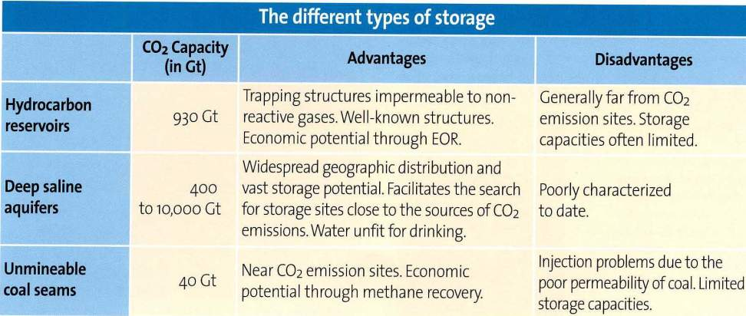
Technologies for CO₂ Storage
jefferson.gomes@abdn.ac.uk

Slide 44
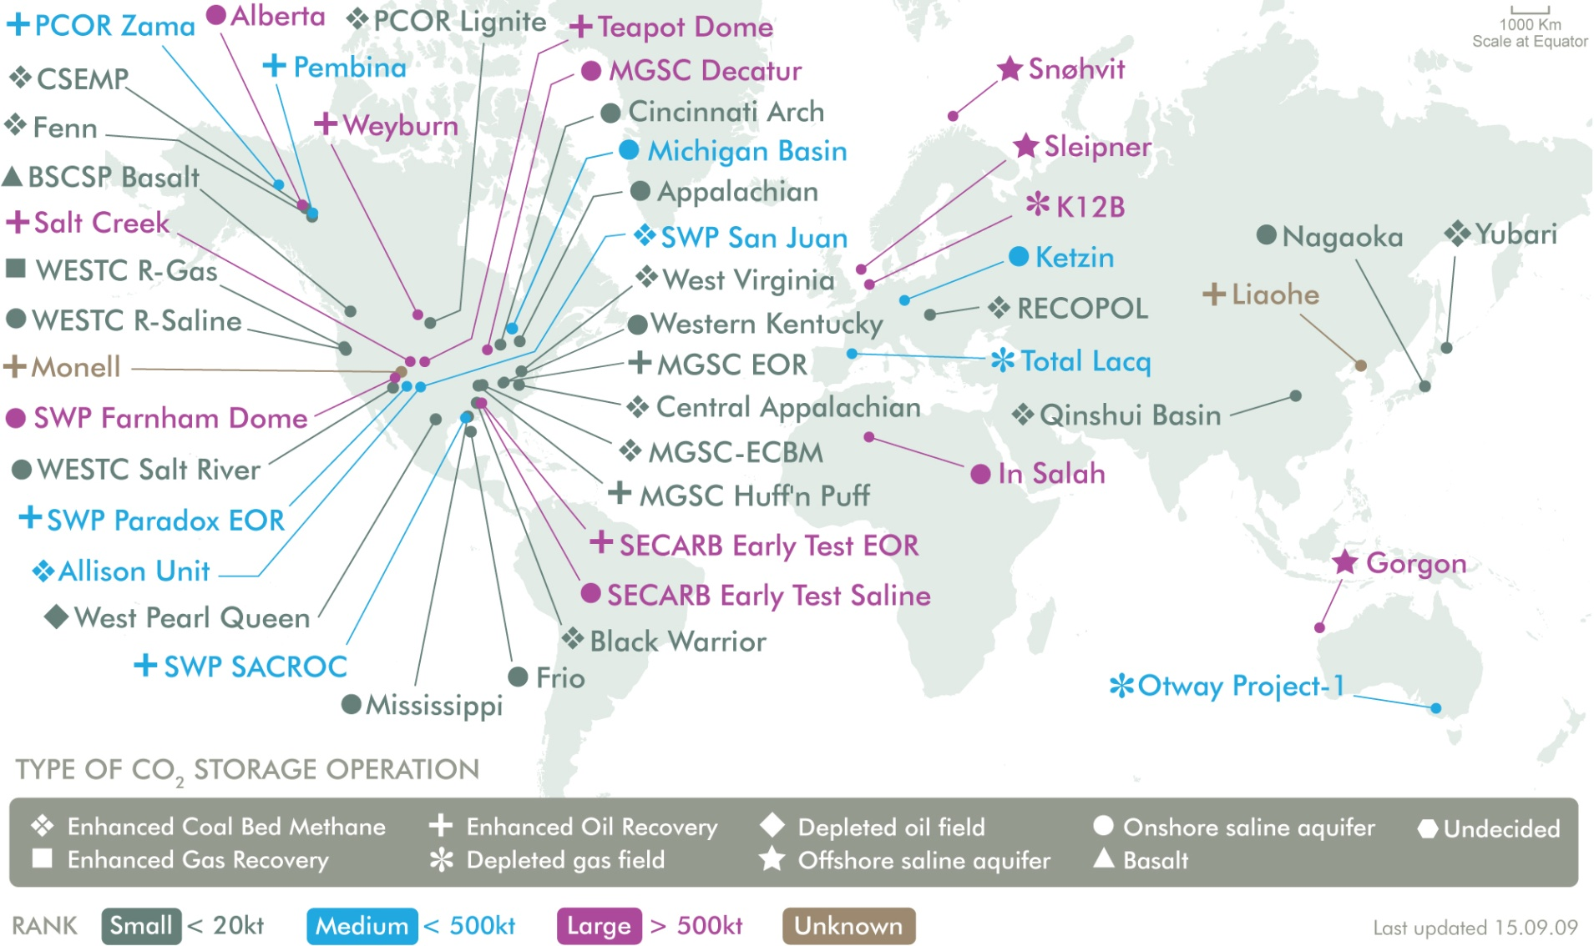
Technologies for CO₂ Storage: Main Facilities
jefferson.gomes@abdn.ac.uk

Slide 45
Technologies for CO₂ Storage: Main Facilities
Country | Location | Capacity (Mt CO₂/year) | Start Year | Storage Type
USA (Texas) | Val Verde (Gas plant) | 1.3 | 1972 | EOR
USA (Oklahoma) | Enid | 0.7 | 1982 | EOR
USA (Wyoming) | Shute Creek | 7 | 1986 | EOR
Norway (North Sea) | Sleipner | 1 | 1996 | LGS
USA (North Dakota) | Great Plains | 3 | 2000 | EOR
Algeria | In Saliah | 1 | 2004 | LGS
Norway (Barents Sea) | Snohvit | 0.7 | 2008 | LGS
USA (Texas) | Century | 8.4 | 2010 | EOR
Total |  | 23.1
LGS: Long-term geological storage
EOR: Enhanced oil recovery
Source: IEA (2013)
jefferson.gomes@abdn.ac.uk

Slide 46
Technologies for CO₂ Storage: Main Geological and Environmental Risks
Leakage of CO₂ (and also CH₄) to atmosphere;
Stress (and overpressure) in the geological structures can cause micro-seismicity leading to small earthquakes;
Migration of CO₂ plumes, displacing brines from the chosen geological formation to others that may contain fresh water (e.g., aquifers);
Decrease soil’s and water’s pH causing (a) calcium dissolution, (b) increasing in water hardness, and (c) release of metals (trace);
Thus monitoring the site is crucial to assess the conditions of the CO₂ plume migration and the reliability of the traping mechanisms.
jefferson.gomes@abdn.ac.uk

Slide 47
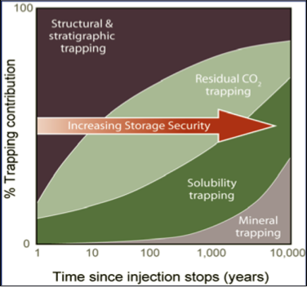
Technologies for CO₂ Storage: Long-Term
CO₂ dissolution in brine:
CO₂ + H₂O → H⁺ + HCO₃⁻
Calcium carbonate dissolution:
CaCO3 + H⁺ + HCO₃⁻ → Ca(HCO₃) ₂
Mineral precipitation:
(Ca, Mg, Fe)⁺² + HCO₃⁻ → (Ca, Mg, Fe) CO₃ + H⁺
CaAl₂Si₂O₈ + 2H⁺ + H₂O → Al₂Si₂O₅(OH)₄
CO₂ dissolves into the reservoir fluids
CO₂ + H₂O is denser than H₂O
CO₂ is ‘slowly’ sequestrated by the minerals
Through time → low probability of CO₂ leakage
jefferson.gomes@abdn.ac.uk

Slide 48
Conclusions
Increase of energy demands → leading to larger GHG emissions;
There is no easy solution for the CO₂ emission problem;
CCS is one of the methods to mitigate GHG emissions along with low-carbon energy sources;
Several technologies for Capture;
Options for CO₂ transport: ships or pipelines;
CO₂ can be stored for a very long time (10000 yr) under high pressure and low temperature conditions;
Linkage with EOR technologies.
Several storage projects have already started
Leakage and other risk should be monitored carefully
jefferson.gomes@abdn.ac.uk

Slide 49
Energy Consumption
Additional Reading
M.E. Boot-Handford et al. (2013) “Carbon Capture and Storage Update”, Energy & Environmental Science, published online on Sept/13 (DOI: 10.1039/C3EE42350F).
N. MacDowell et al. (2010) “An Overview of CO2 Capture Technologies”, Energy & Environmental Science, 3:1645-1669 (DOI: 10.1039/C004106H).
B. Nykvist (2013) “Ten times more difficult: Quantifying the carbon capture and storage challenge”, Energy Policy, 5:683-689 (DOI: 10.1016/j.enpol.2012.12.026).
EU Directive 2009/31/EC on the geological storage of carbon dioxide (http://eur-lex.europa.eu/LexUriServ/LexUriServ.do?uri=OJ:L:2009:140:0114:0135:EN:PDF).
International Energy Outlook 2013 (DoE/EIA-0484): http://www.eia.gov/forecasts/ieo/pdf/0484(2013).pdf
Annual Energy Review 2011 (DoE/EIA-0384): http://www.eia.gov/totalenergy/data/annual/pdf/aer.pdf
J.G.J. Olivier (2013) “Trends in Global CO2 Emissions: 2013 Report”, PBL Netherlands Environmental Assessment Agency: http://www.pbl.nl/sites/default/files/cms/publicaties/pbl-2013-trends-in-global-co2-emissions-2013-report-1148.pdf
IEA (2013) “CO2 Capture Facilities and Capacities”: http://www.iea.org/etp/tracking/ccs/
IEA (2011) “Technology Roadmap: Carbon Capture and Storage in Industrial Applications”: http://www.iea.org/publications/freepublications/publication/ccs_industry.pdf
IPCC (2005) “IPCC Special Report on Carbon Dioxide Capture and Storage”: http://www.ipcc.ch/pdf/special-reports/srccs/srccs_wholereport.pdf
jefferson.gomes@abdn.ac.uk

